Slide 1
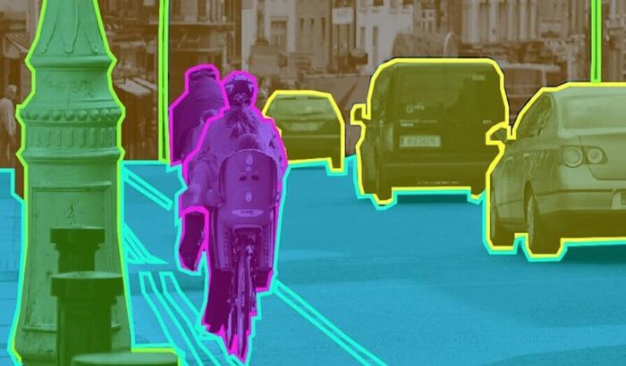
Exploring Object Detection & its Applications
Ishan Khanka
Avantika Singh

Slide 2

Introduction

Slide 3

Object Detection : An Overview
Object Detection is a common Computer Vision problem which deals with identifying and locating objects of certain classes in images.
When humans look at images or video, we can recognize and locate objects of interest within a matter of moments. The goal of object detection is to replicate this intelligence using a computer.
Given a set of object classes, object detection helps in determining the location and scale of all object instances, if any, that are present in an image.
Object Detection provides the means for doing exactly that.

Slide 4
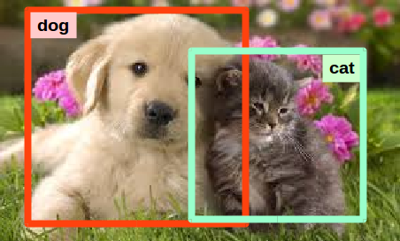
Image Classification To Image Detection
To explore the concept of object detection we begin with image classification that goes through levels of incremental complexity.
Image Classification: Image classification is where a model can analyze an image and identify the ‘target class’ the image falls under essentially answering the question “What is in this picture?”
Object Localization: It is used to locate the presence of an object in the image and represent it with a bounding box in the form of (position, height, and width) essentially answering the question “What is it and where it is?”
However, in a real real-life scenario, we need to go beyond locating just one object in a given image.
We need systems that are capable of detecting multiple objects in an image and Object Detection provides the means for doing exactly that.

Slide 5
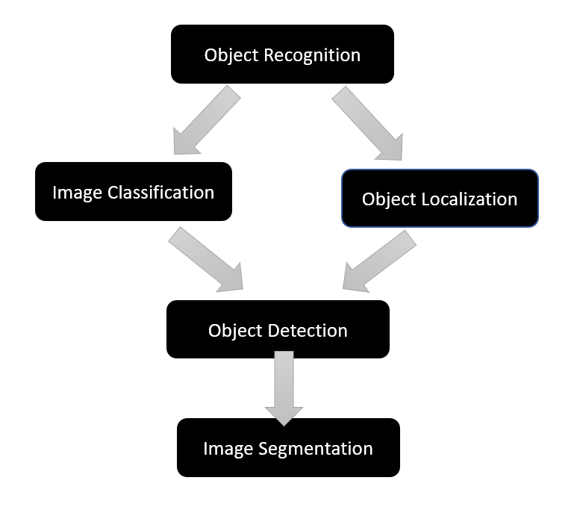
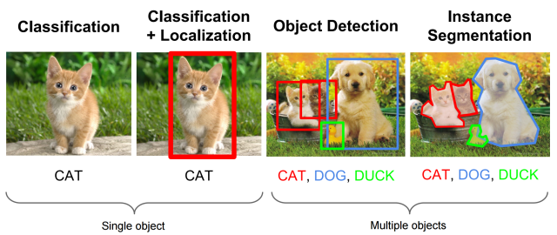
Object Detection: Object Detection algorithms act as a combination of Image classification and Object localization. It takes an image as input and produces one or more bounding boxes with the class label attached to each bounding box. Object detection models are capable enough to deal with multi-class classification, object localization as well as with objects with multiple occurrences.
Image Segmentation: Image segmentation is a further extension of object detection in which we mark the presence of an object through pixel-wise masks generated for each object in the image which helps us in determining the shape of the object.

Slide 6
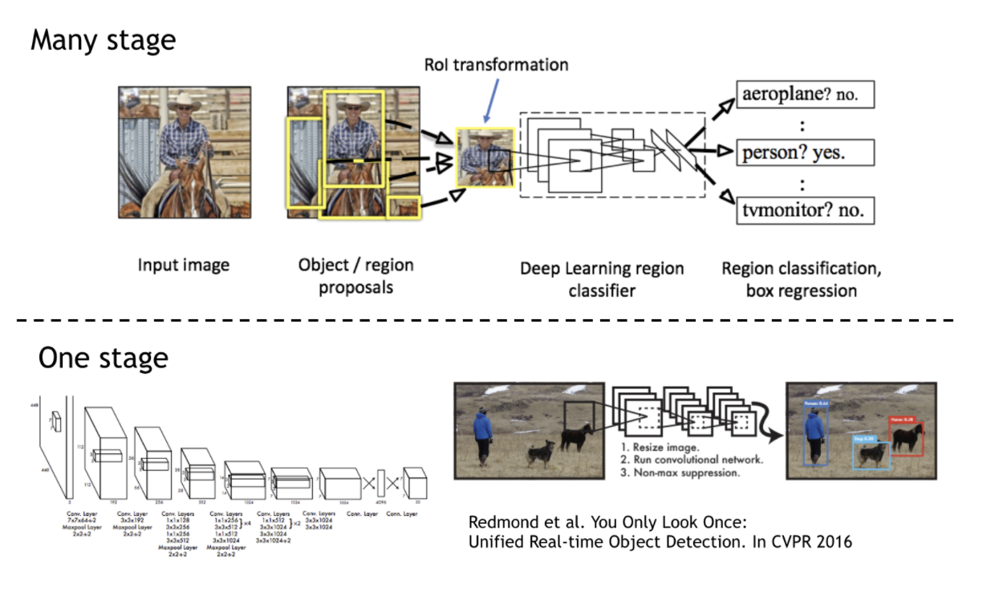
Object Detection Using Deep Learning
Object detection algorithms can be categorized into two main types:
One-stage methods and Two stage-methods.
1. Two-stage methods: Algorithms based on Classification
The initial stage of two-stage networks, identifies region proposals, or subsets of the image that might contain an object.
The second stage classifies the objects within the region proposals using convolutional neural networks.
Two-stage methods prioritize detection accuracy, and example models include R-CNN (region-based convolutional neural network), Faster R-CNN, Mask R-CNN and Cascade R-CNN.
2. One-stage methods: Algorithms based on Regression
Instead of selecting interesting parts of an image, one-stage methods predict classes and bounding boxes for the whole image in one run of the algorithm.
In single-stage networks, the CNN produces network predictions for regions across the entire image using anchor boxes, and the predictions are decoded to generate the final bounding boxes for the objects.
Single-stage networks can be much faster than two-stage networks, but they may not reach the same level of accuracy, especially for scenes containing small objects example models include YOLO, SSD (Single Shot Multibox Detector)

Slide 7

Problem Statement

Slide 8
Our objective is to build a model for object detection using image datasets.
We plan to run the model on GPU’s available on cloud platform and Baremetal.
We seek to analyze/compare their relative performance on these different platforms based on the execution time as well as the model’s loss function thereby accounting for both the cloud and machine learning aspects of this course.
Furthermore, we will be creating a web application that users could use to detect common objects or different types of blood cells in images uploaded by them.

Slide 9

Related Work & Models Used

Slide 10
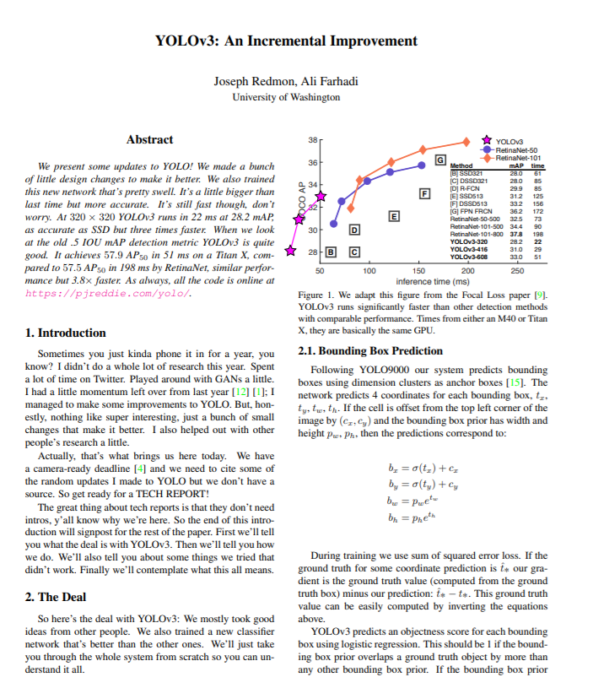
References
Tiny Yolov3
Yolo v3 : https://pjreddie.com/darknet/yolo/
Papers With Code: https://paperswithcode.com/method/yolov3
YOLO v3-Tiny: Object Detection and Recognition using one stage improved model https://ieeexplore.ieee.org/document/9074315
Towards DataScience https://towardsdatascience.com/yolo-v3-object-detection-53fb7d3bfe6b

Slide 11
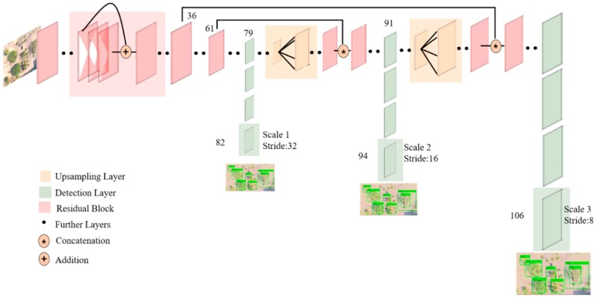
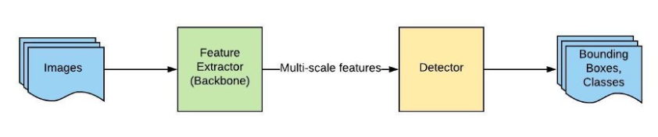
Yolo v3 Network Architecture:
YOLO (“You Only Look Once”) is an effective real-time object recognition algorithm, first described in the seminal 2015 paper by Joseph Redmon.
YOLO v3 uses a variant of Darknet, which originally has 53-layer network trained on Imagenet. For the task of detection, 53 more layers are stacked onto it, giving us a 106 layer fully convolutional underlying architecture for YOLO v3.
Feature Extraction and Detection:
The whole system can be divided into two major components: Feature Extractor and Detector; both are multi-scale.
When a new image comes in, it goes through the feature extractor first so that we can obtain feature embeddings at three (or more) different scales.
Then, these features are feed into three (or more) branches of the detector to get bounding boxes and class information.

Slide 12
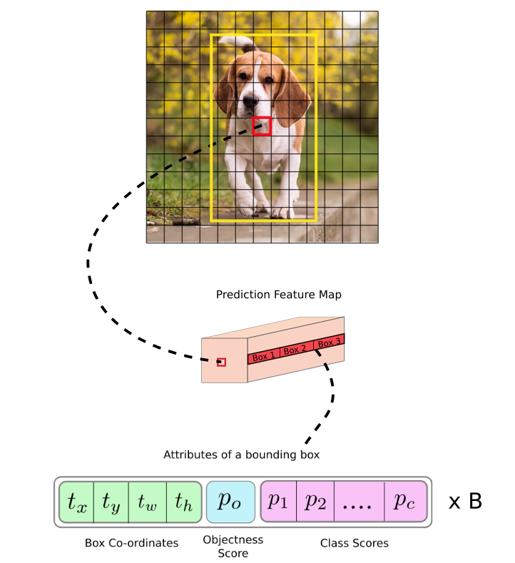
Detection at three scales
The most salient feature of v3 is that it makes detections at three different scales.
The stride of the network, or a layer is defined as the ratio by which it down samples the input .
YOLO v3 makes prediction at three scales by down sampling the dimensions of the input image by 32, 16 and 8 respectively.
The first detection is made by the 82nd layer. Then, the second detection is made by the 94th layer and the final at the 106th layer.
In YOLO v3, the detection is done by applying 1 x 1 detection kernels on feature maps of three different sizes at three different places in the network.
The shape of the detection kernel is 1 x 1 x (B x (5 + C) ).
Here B is the number of bounding boxes a cell on the feature map can predict, “5” is for the 4 bounding box attributes and one object confidence, and C is the number of classes.
In YOLO v3 trained on COCO, B = 3 and C = 80, so the kernel size is 1 x 1 x 255.

Slide 13
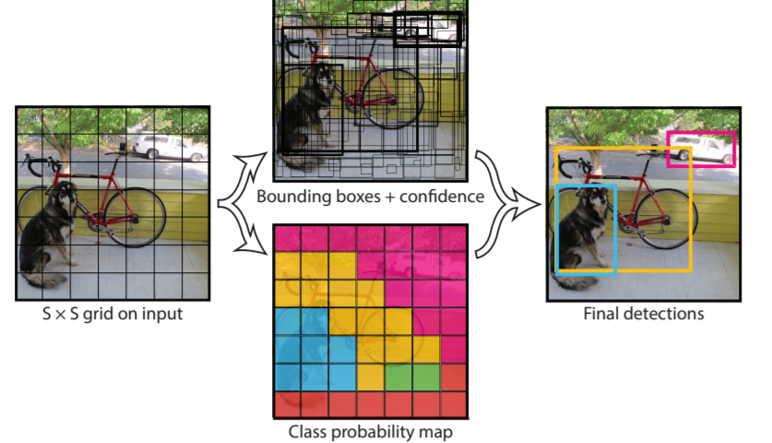
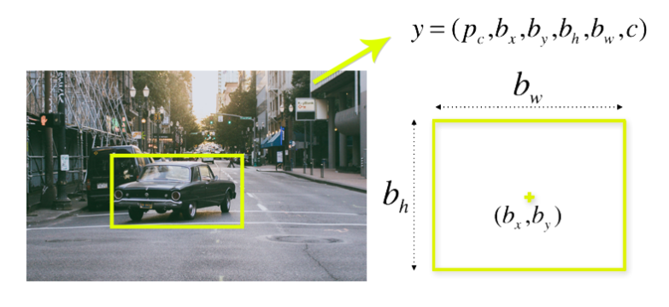
Bounding Boxes: Each bounding box can be described using four parameters:
center of a bounding box (bxby)
width (bw)
height (bh)
value c is corresponding to a class of an object (such as: car, traffic lights, etc.).
We have to predict the pc value, which is the probability that there is an object in the bounding box.
We take an image and split it into an SxS grid, within each of the grid we take m bounding boxes. For each of the bounding box, the network outputs a class probability and offset values for the bounding box. The bounding boxes having the class probability above a threshold value is selected and used to locate the object within the image.

Slide 14
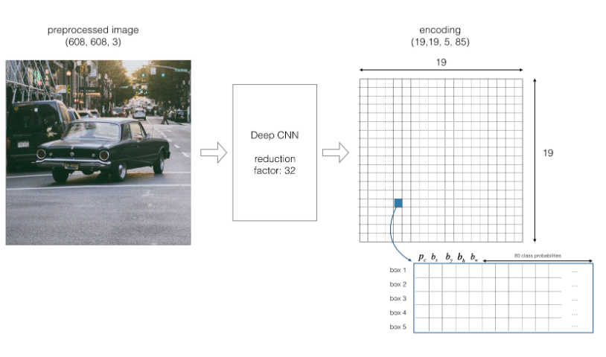
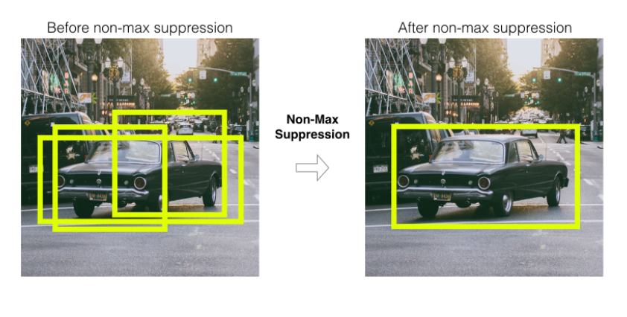
With the YOLO algorithm we are not searching for interesting regions in our input image that could potentially contain an object.
Instead, we are splitting our image into cells. Each cell is responsible for predicting bounding boxes. Therefore, we arrive at a large number of bounding boxes for one image.
Most of these cells and bounding boxes will not contain an object.
Therefore, we use value pc, which serves to remove boxes with low object probability and bounding boxes with the highest shared area in a process called non-max suppression

Slide 15
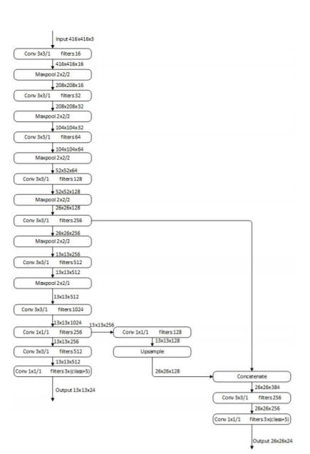
Tiny-Yolov3 Model
The tiny-yolov3 model is a simplified version of the YOLOV3 model.
YOLOV3 uses the architecture of darknet53, and then uses many 1x1 and 3x3 convolution kernels to extract features.
Tiny-yolov3 reduces the number of convolutional layers, its basic structure has only 7 convolutional layers, and then features are extracted by using a small number of 1x1 and 3x3 convolutional layers.
Tiny-yolov3 uses the pooling layer instead of YOLOV3’s convolutional layer with a step size of 2 to achieve dimensionality reduction

Slide 16

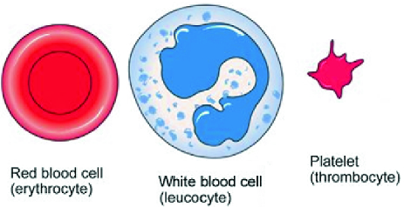
Datasets and Use Cases
BCCD

Slide 17
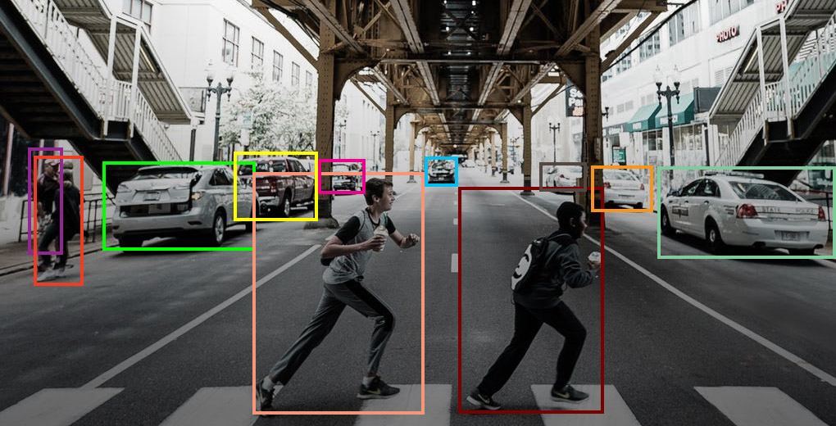
Coco Dataset
Common Objects in Context
330K images (>200K labeled)
1.5 million object instances
80 object categories
5 captions per image

Slide 18
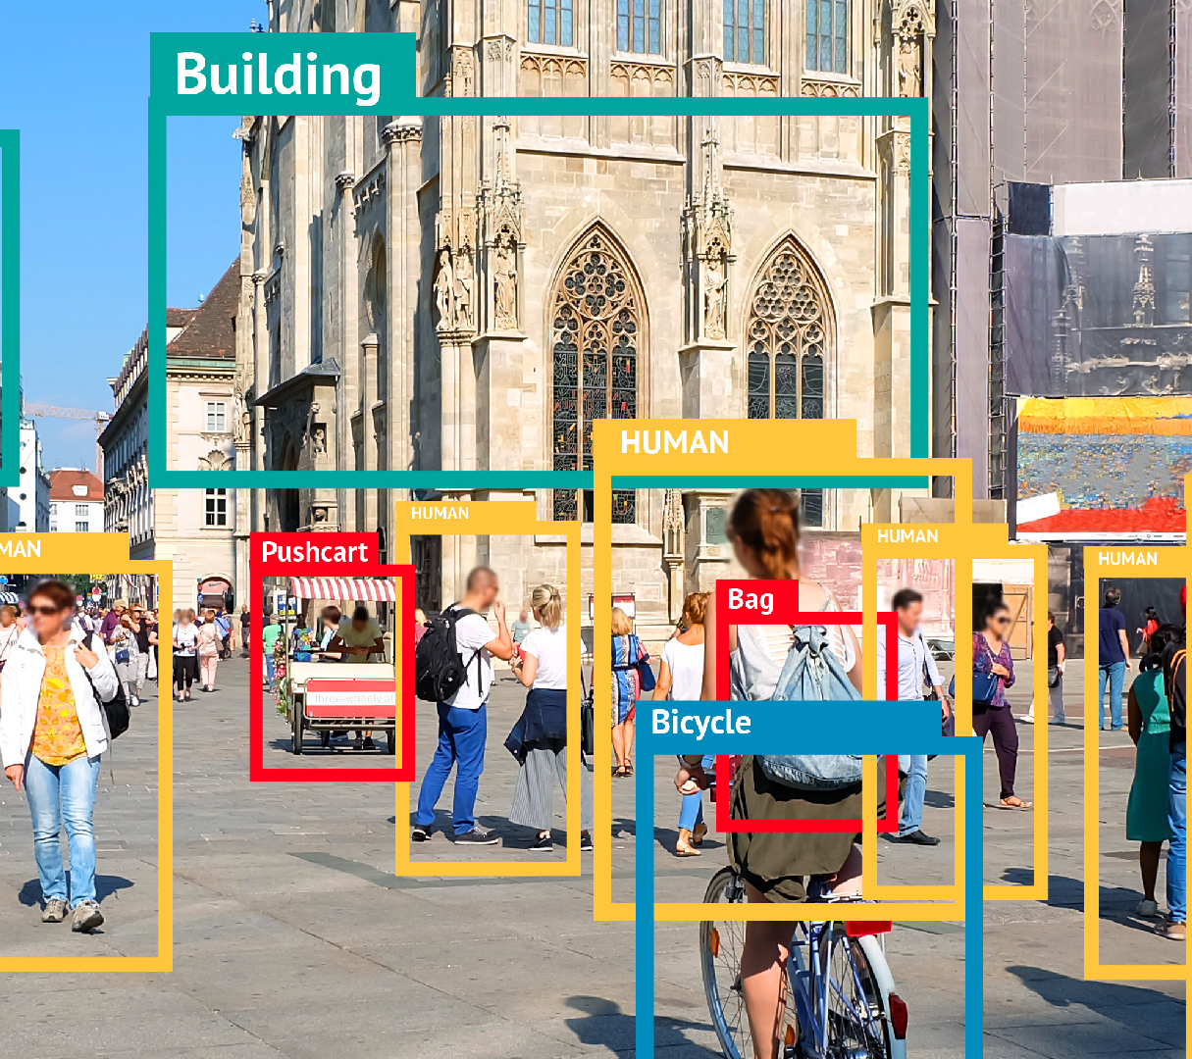
Object Detection for COCO
Object detection is breaking into a wide range of industries, with use cases ranging from personal security to productivity in the workplace. Object detection and recognition is applied in many areas of computer vision, including image retrieval, security, surveillance, automated vehicle systems and machine inspection.

Slide 19
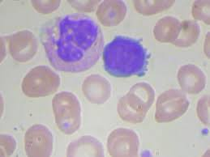
BCCD
Blood Cell Count and Detection
There are 364 images across three classes:
WBC (white blood cells)
RBC (red blood cells),
Platelets.
There are 4888 labels across 3 classes

Slide 20
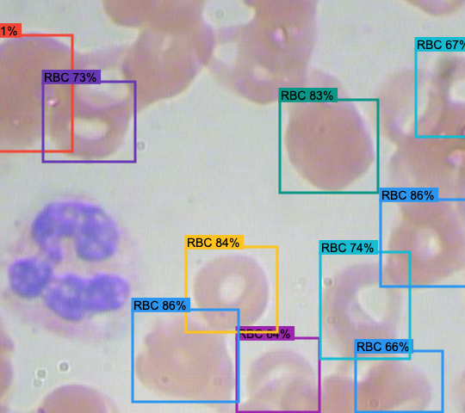
Object Detection for Blood cell detection and counting
Counting the number of white blood cells(WBC’s),red blood cells(RBC’s) and platelets in the blood is an important test for evaluating the health of an individual. The lack or excess of any one of these could be the sign of a potential disease and could lead to severe health problems. Traditionally blood cells are counted manually using haemocytometer along with other laboratory equipment's and chemical compounds, which is a time-consuming and tedious task. Hence, the use of deep learning-based systems for detection and counting enables us to count blood cells from smear images in less than a second, which is useful for practical applications.

Slide 21


Training
Bare Metal

Slide 22
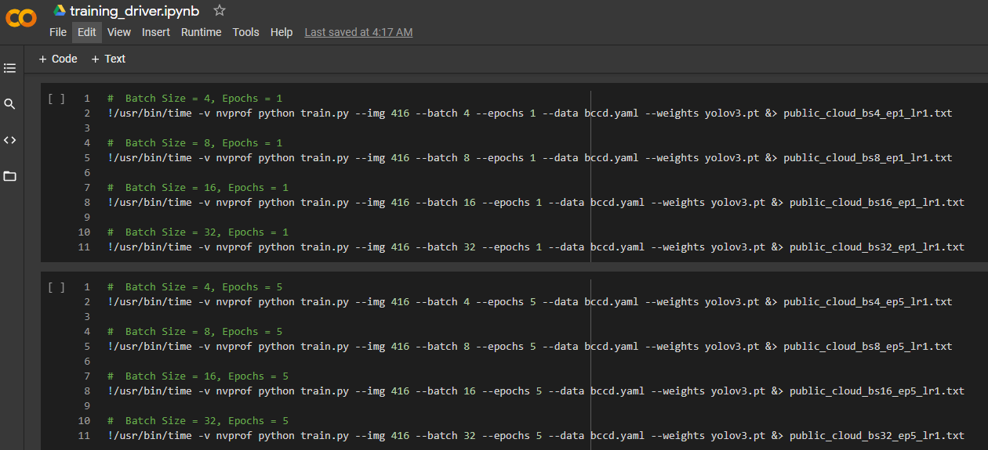
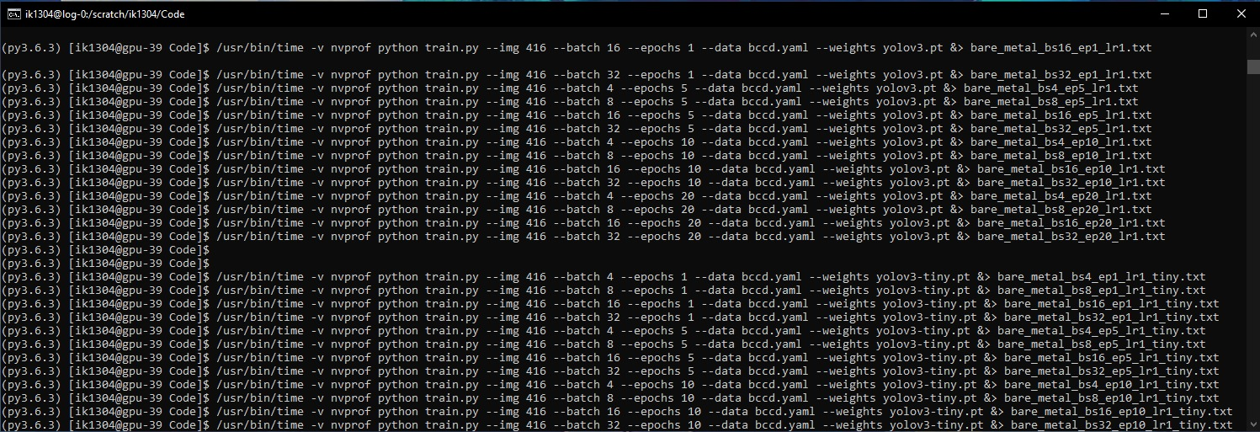
Experiment setup
For training the model we use the following hyperparameter configurations:
Epochs : 1, 5, 10, 20
Batch size : 4, 8,16, 32
Models : YOLO and YOLO Tiny
Execution environment:
Cloud : Tesla T4, 15079MB
BareMetal : Tesla P40, 22919MB
Total Experiments: 64

Slide 23
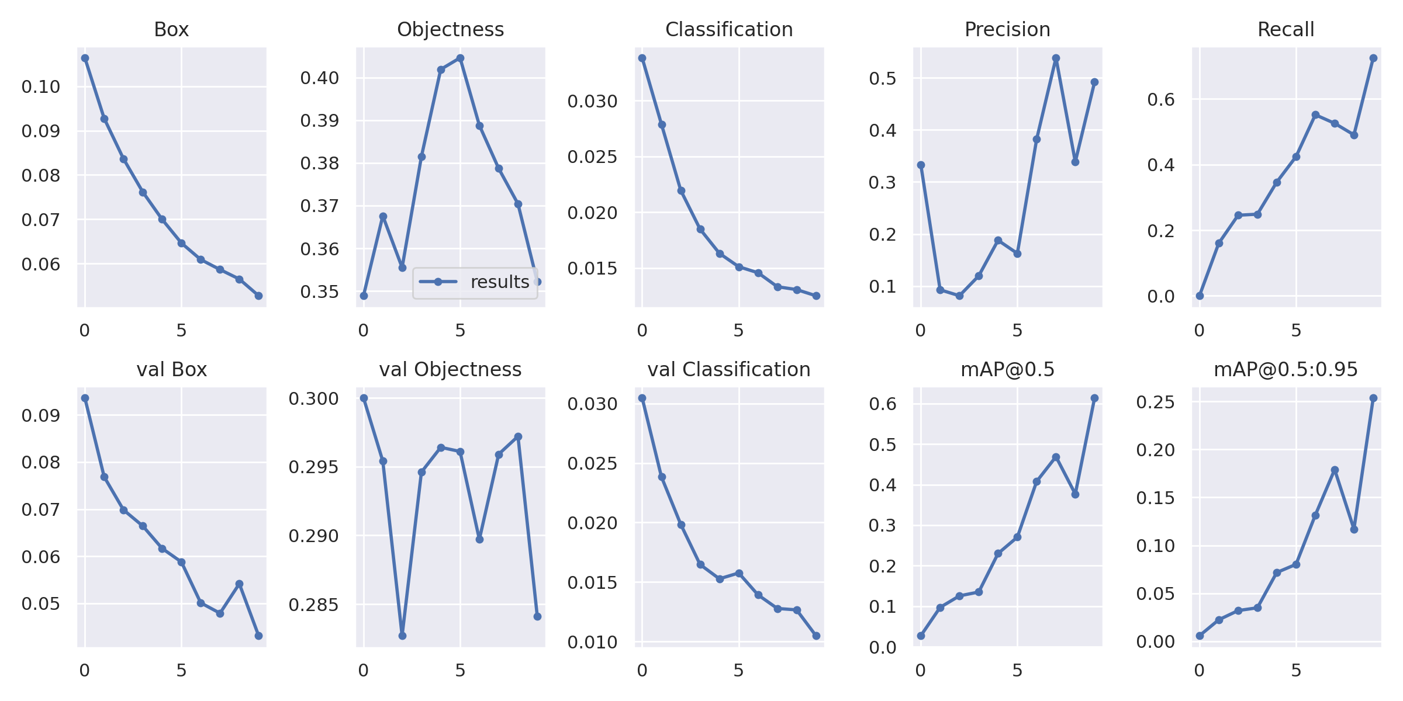
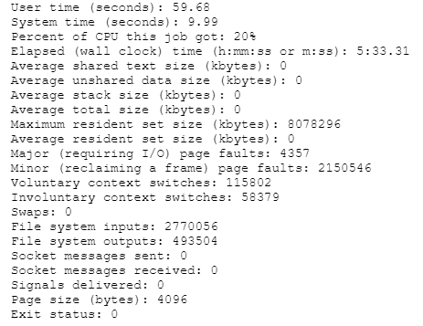
Data Collected
Metrics for model performance
Precision
Recall
Objectness score
Classification score
Profiling
User time (seconds)
Percent of CPU a job got
Maximum resident set size (kbytes)
NVPROF profiling (Avg. time for biggest GPU activity)
Objectness score : measure how well the detector identifies the locations and classes of objects during navigation
Classification score : identify if an object is present in the image and the class of the object
Precision : tp / (tp + fp) or how many selected items are relevant
Recall : tp / (tp + fn) or how many relevant items are selected

Slide 24



Demo of Inference

Slide 25
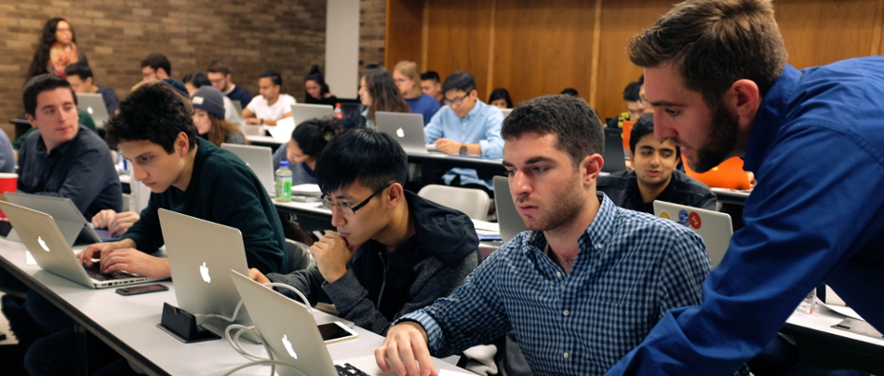
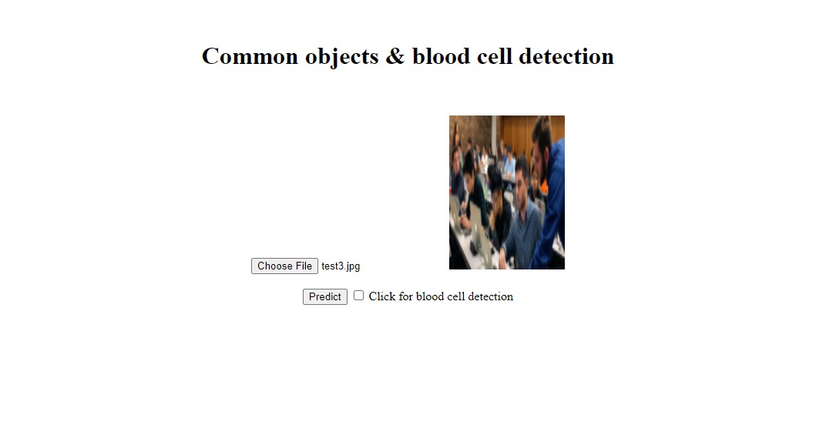
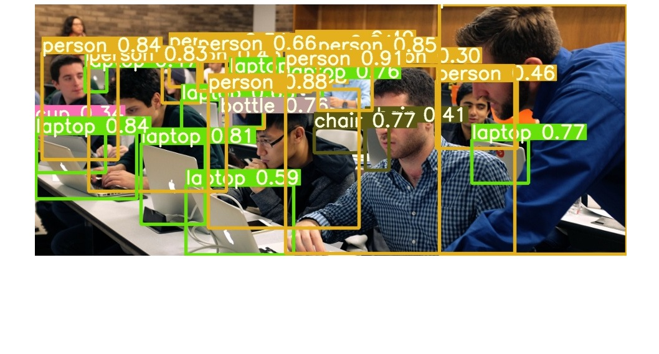
Test Case1: Common Object Detection

Slide 26
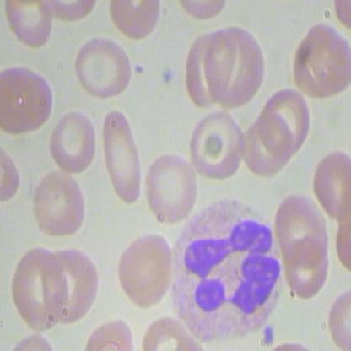
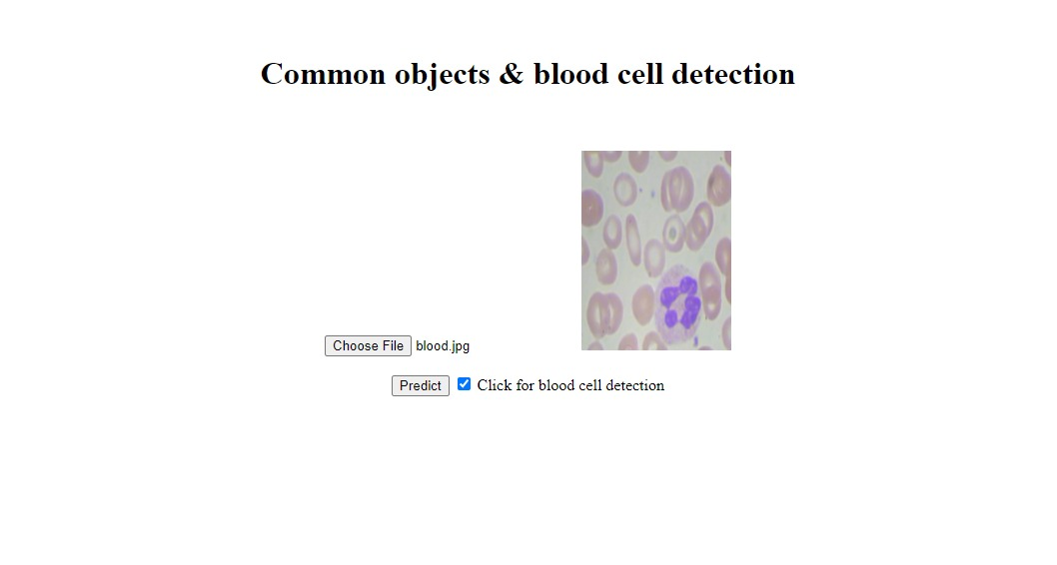
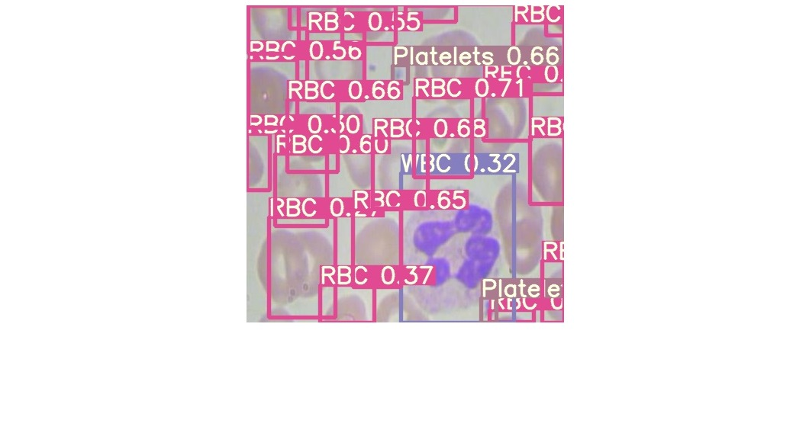
Test Case2: Blood Cell Detection

Slide 27
Inference: http://159.122.181.44:32073/

Slide 28

Results/Evaluation

Slide 29
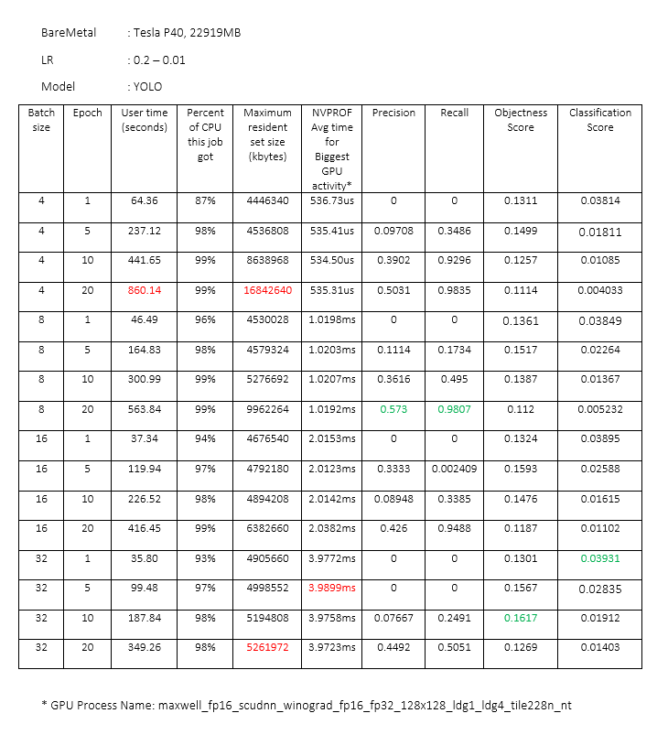
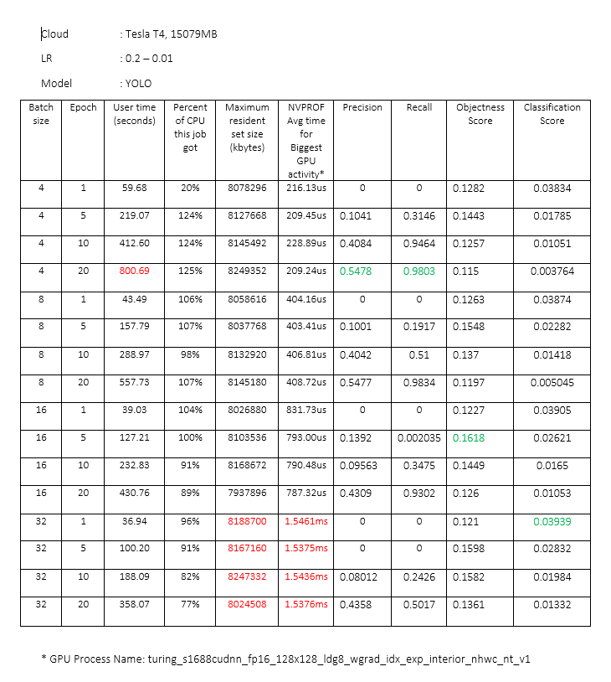
YOLO v3

Slide 30
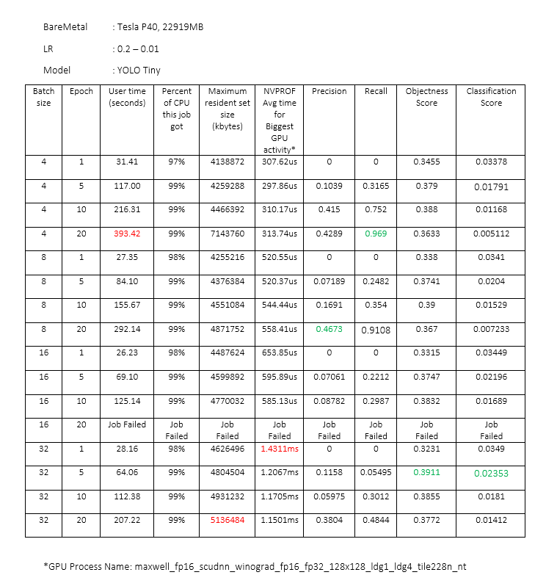
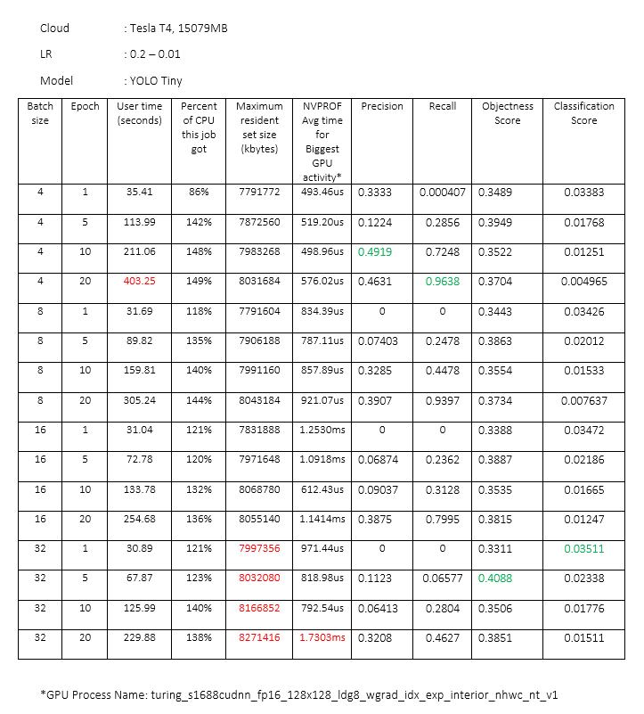
Tiny Yolov3

Slide 31
Model
Yolo Tiny trains faster irrespective of training platform (cloud or baremetal)
Inference: Lesser layers in Yolo tiny
Both models reach higher objectness score for batch size 32 irrespective of the number of epochs
Inference: Move inclusive dataset (containing all the classes)
Higher precision or recall
Inference:
For Blood Cell detection - recall is a better as our priority is how many relevant items are selected
For common object detection - precision is better as our priority is how many selected items are relevant
Execution Environment:
More consistent metrics for use of resources in baremetal for specific batch size
Inference: Due to no sharing of resources on baremetal
Diff in time and way of handling same matrix multiplication while training – GPU in Cloud is faster:
Inference:
Different architecture of GPU (Maxwell – baremetal vs Turing - cloud)
Cloud give easy and faster access to latest (Sep 2018 vs Sep 2016) without maintenance costs
Higher CPU usage in cloud
Inference: More movement of data in cloud as the data was streamed to and from other storage
Objectness score : measure how well the detector identifies the locations and classes of objects during navigation
Classification score : identify if an object is present in the image and the class of the object
Precision : tp / (tp + fp) or how many selected items are relevant
Recall : tp / (tp + fn) or how many relevant items are selected

Slide 32
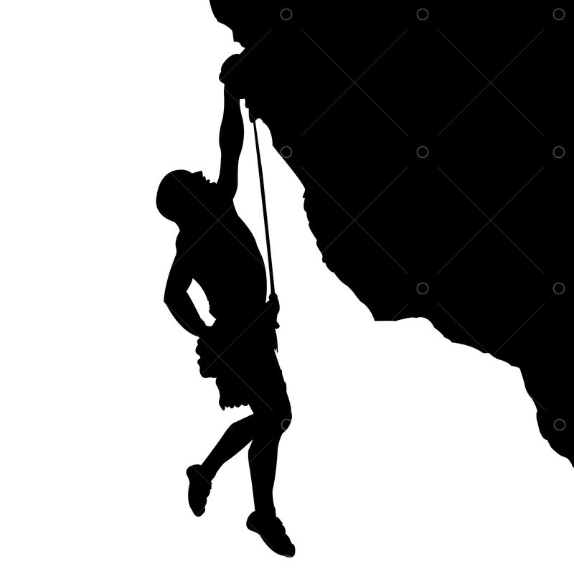
Challenges and Lessons Learned

Slide 33
Deploying object detection models generally takes A LOT of memory and computation power, especially on machines we use daily.
Used Yolo tiny for inference due to faster and compact size
Running 64 experiments and analyzing the results was a little tedious and time consuming.
Working our way through the Yolo framework required significant research.
In order to use the model on a custom dataset we had to figure a way to generate labels for the BCCD dataset.
All object detection frameworks continue to struggle with small objects, especially those bunched together with partial occlusions.

Slide 34

Conclusion and Future Work

Slide 35
Conclusion
Cloud provides access to latest and faster GPU but BareMetal provides better reservation of resources.
Tiny YOLO trains faster, gives nearly same performance with smaller model size
We were successful in creating a web application which can be used to detect both cases with just a flick of checkbox
The results discussed showed good insights for:
Model training – Which metrics matters and what should be the hyperparameters for best accuracy
Execution environment – How training the same application in different environments shows a stark difference:
model evaluation and experimentation – BareMetal
Deployment with low maintenance cost – Cloud

Slide 36
Future Work
More in-depth evaluation of logs and model collected for each experiment ( 10 GB of data & 64,000 lines of logs)
Front end with option to train with user provided hyperparameters
Add form fields where the user can key in hyperparameters like batch size, learning rate, epochs etc.
This would allow user to train and then immediately test out the performance of the model
Instead of multi model approach, create single model for both use cases (blood cell and common object detection)
Make use of image segmentation for better localization of objects

Slide 37
Thank you!

